Slide 1
Chữ A
Cô Trang
Prepared by My Trang Nguyen Vietnamese Cultural Schools Association Inc. Bankstown 2020

Slide 2
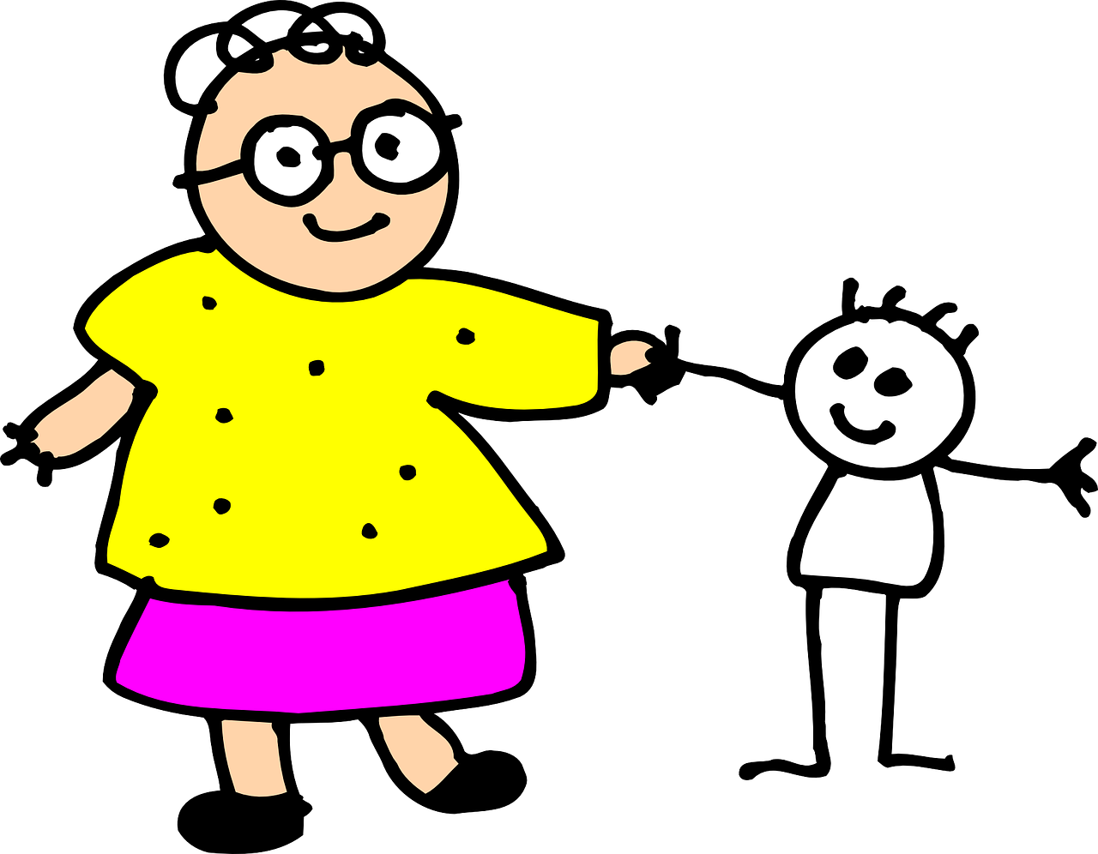
Bà
https://cliparting.com/mom-clipart/
Prepared by My Trang Nguyen Vietnamese Cultural Schools Association Inc. Bankstown 2020

Slide 3
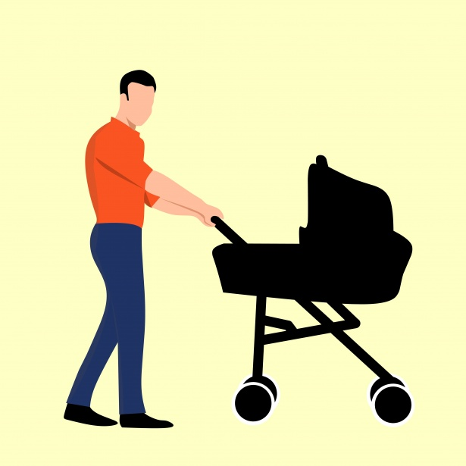
Ba
https://www.publicdomainpictures.net/en/hledej.php?hleda=move
Prepared by My Trang Nguyen Vietnamese Cultural Schools Association Inc. Bankstown 2020

Slide 4
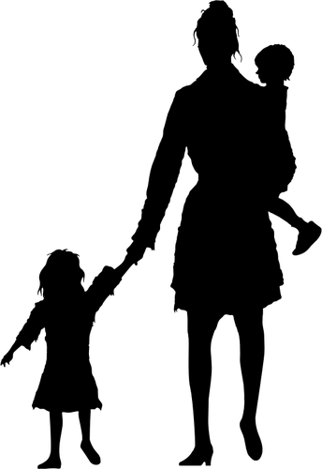
Má
https://www.dreamstime.com/stock-photography-mom-1-image6669652
Prepared by My Trang Nguyen Vietnamese Cultural Schools Association Inc. Bankstown 2020

Slide 5
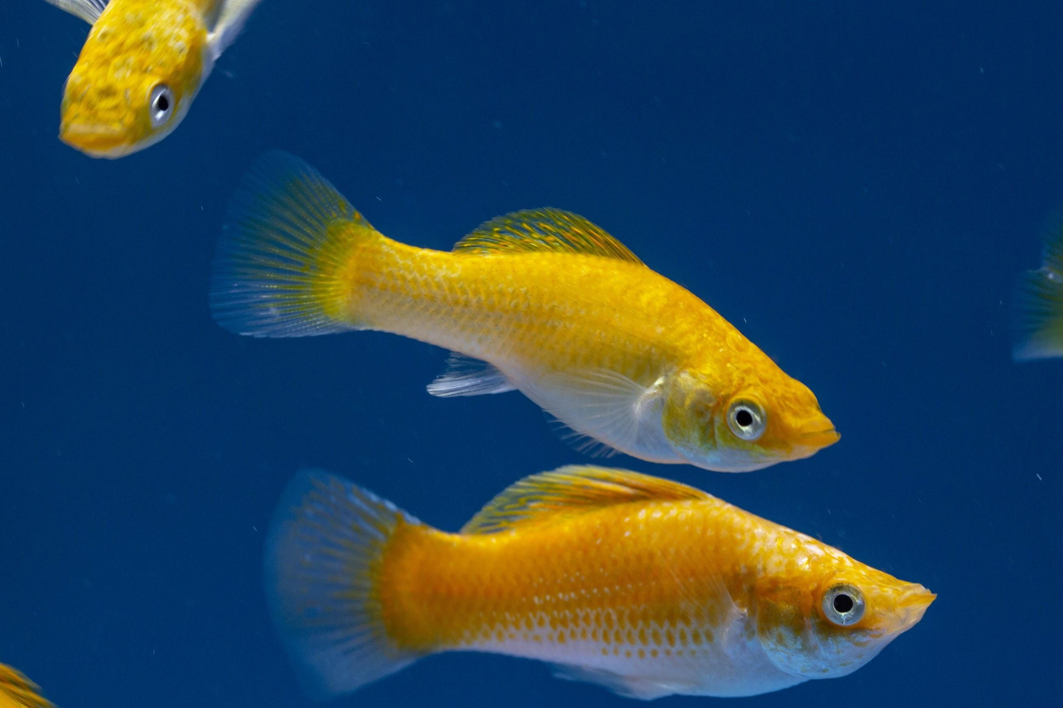
Cá
Prepared by My Trang Nguyen Vietnamese Cultural Schools Association Inc. Bankstown 2020

Slide 6
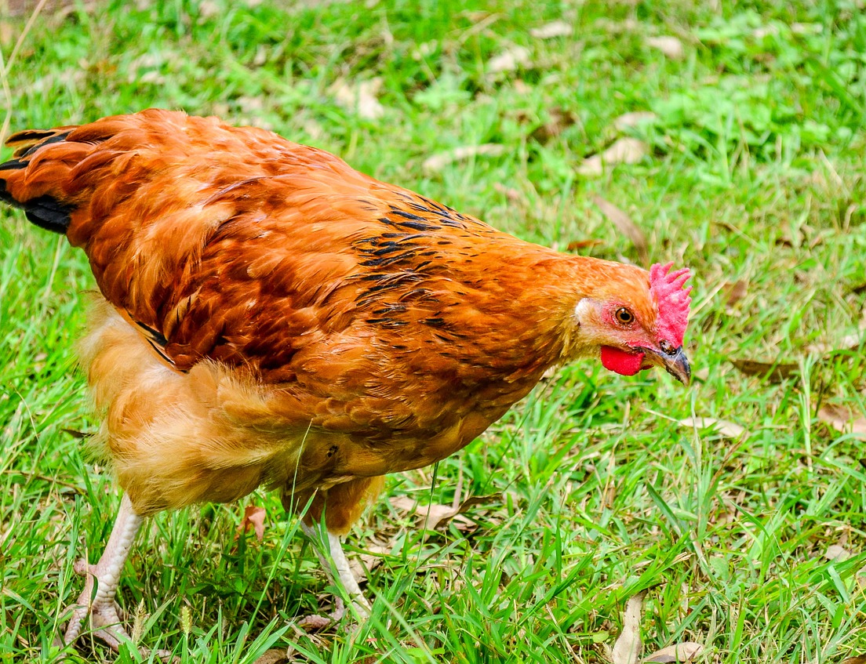
Gà
https://pixabay.com/photos/chicken-fowl-hen-farm-bird-1214474/
Prepared by My Trang Nguyen Vietnamese Cultural Schools Association Inc. Bankstown 2020

Slide 7
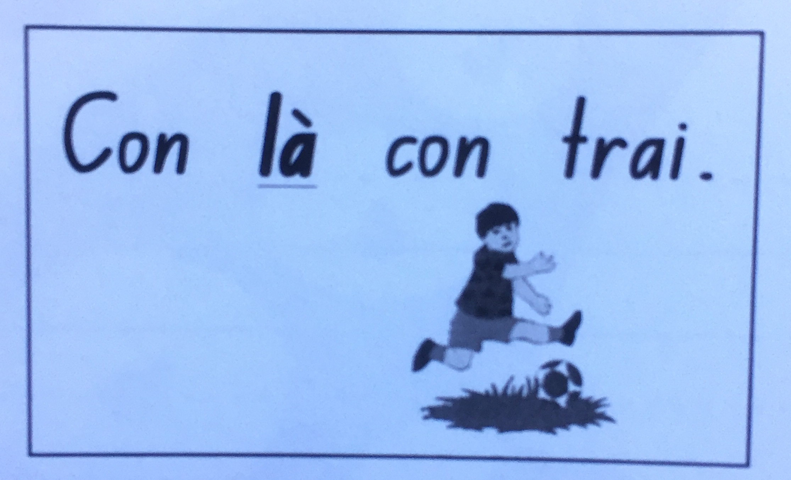
Prepared by My Trang Nguyen Vietnamese Cultural Schools Association Inc. Bankstown 2020

Slide 8
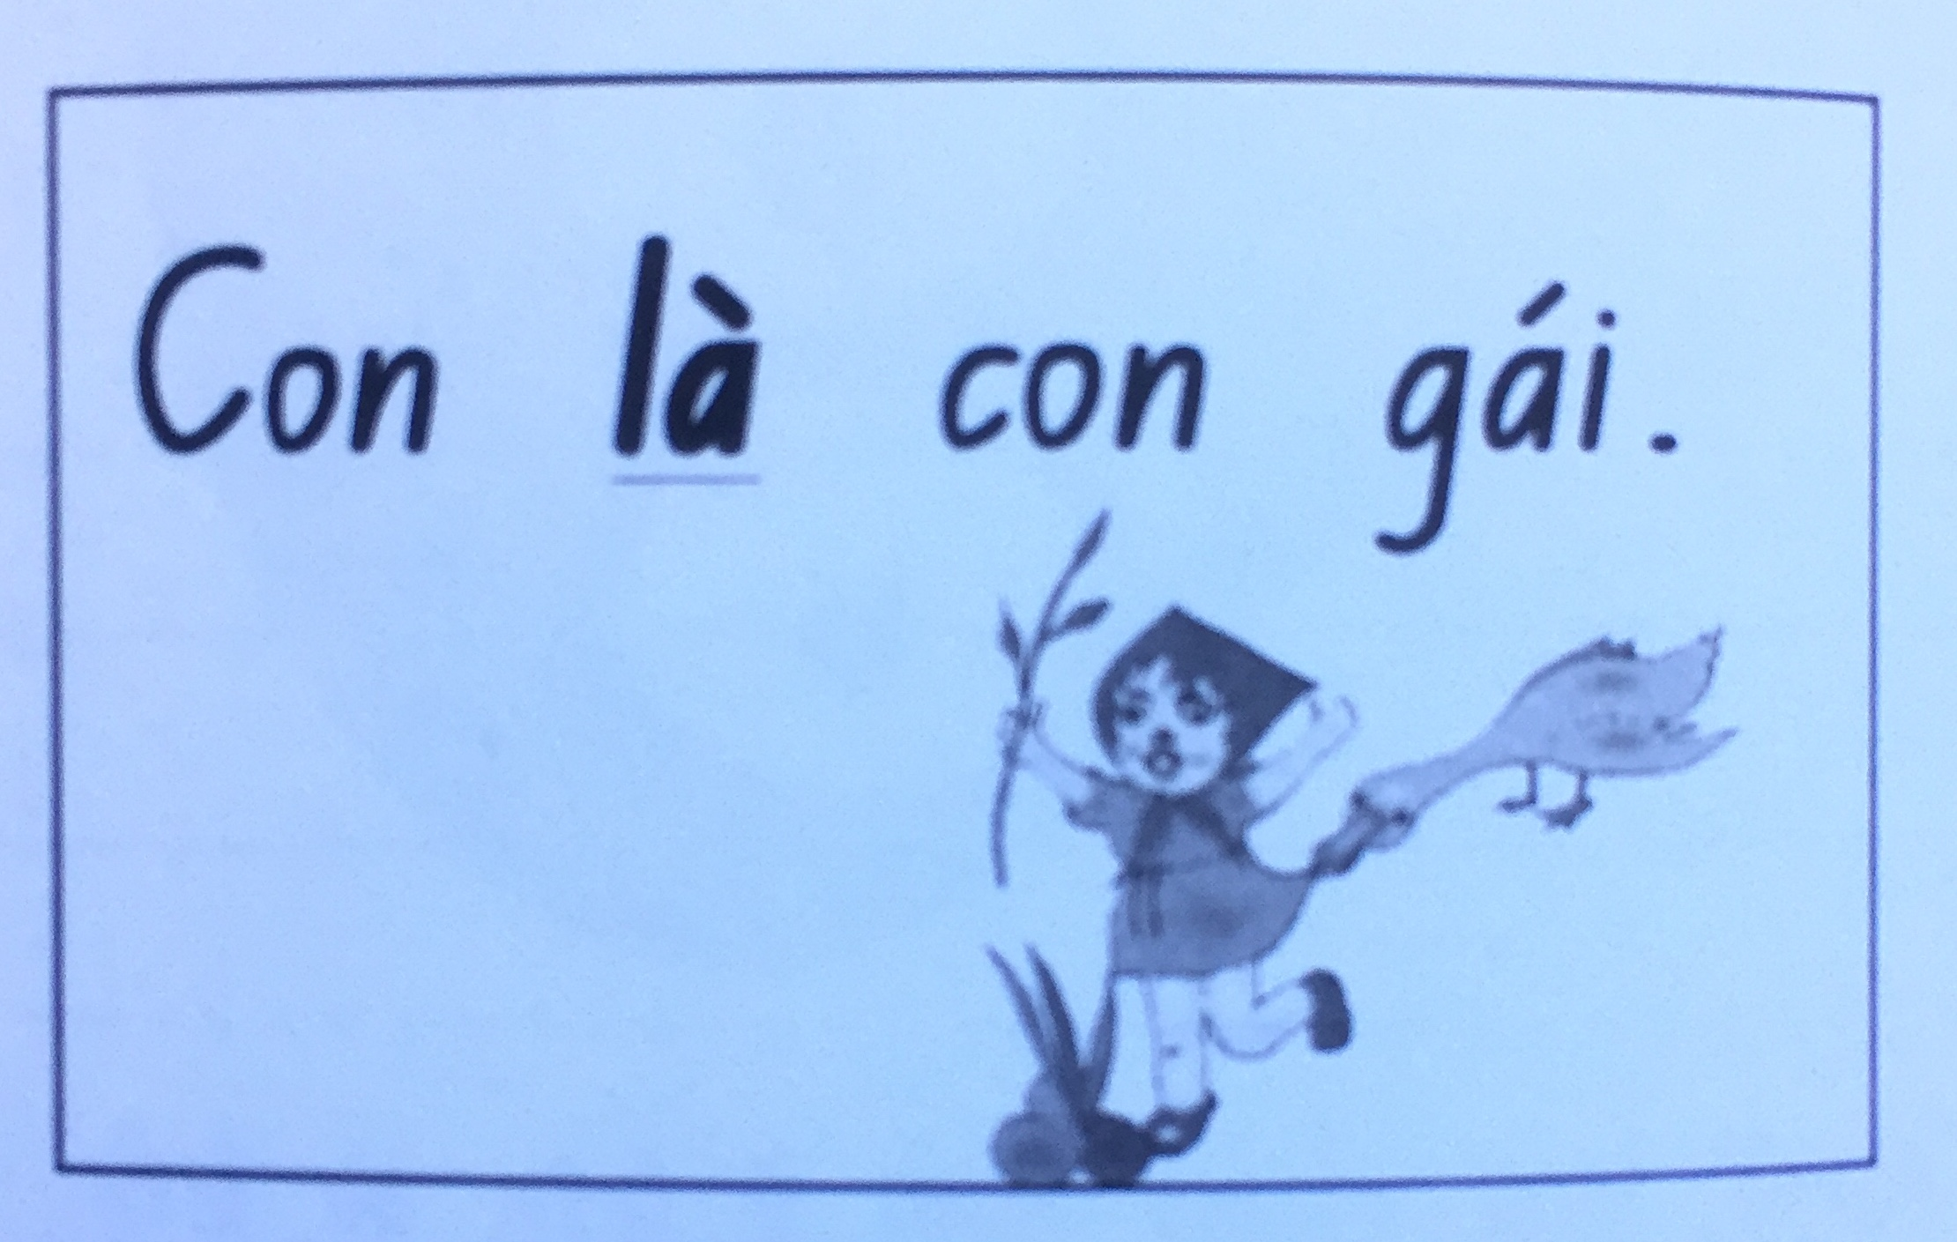
Prepared by My Trang Nguyen Vietnamese Cultural Schools Association Inc. Bankstown 2020

Slide 9
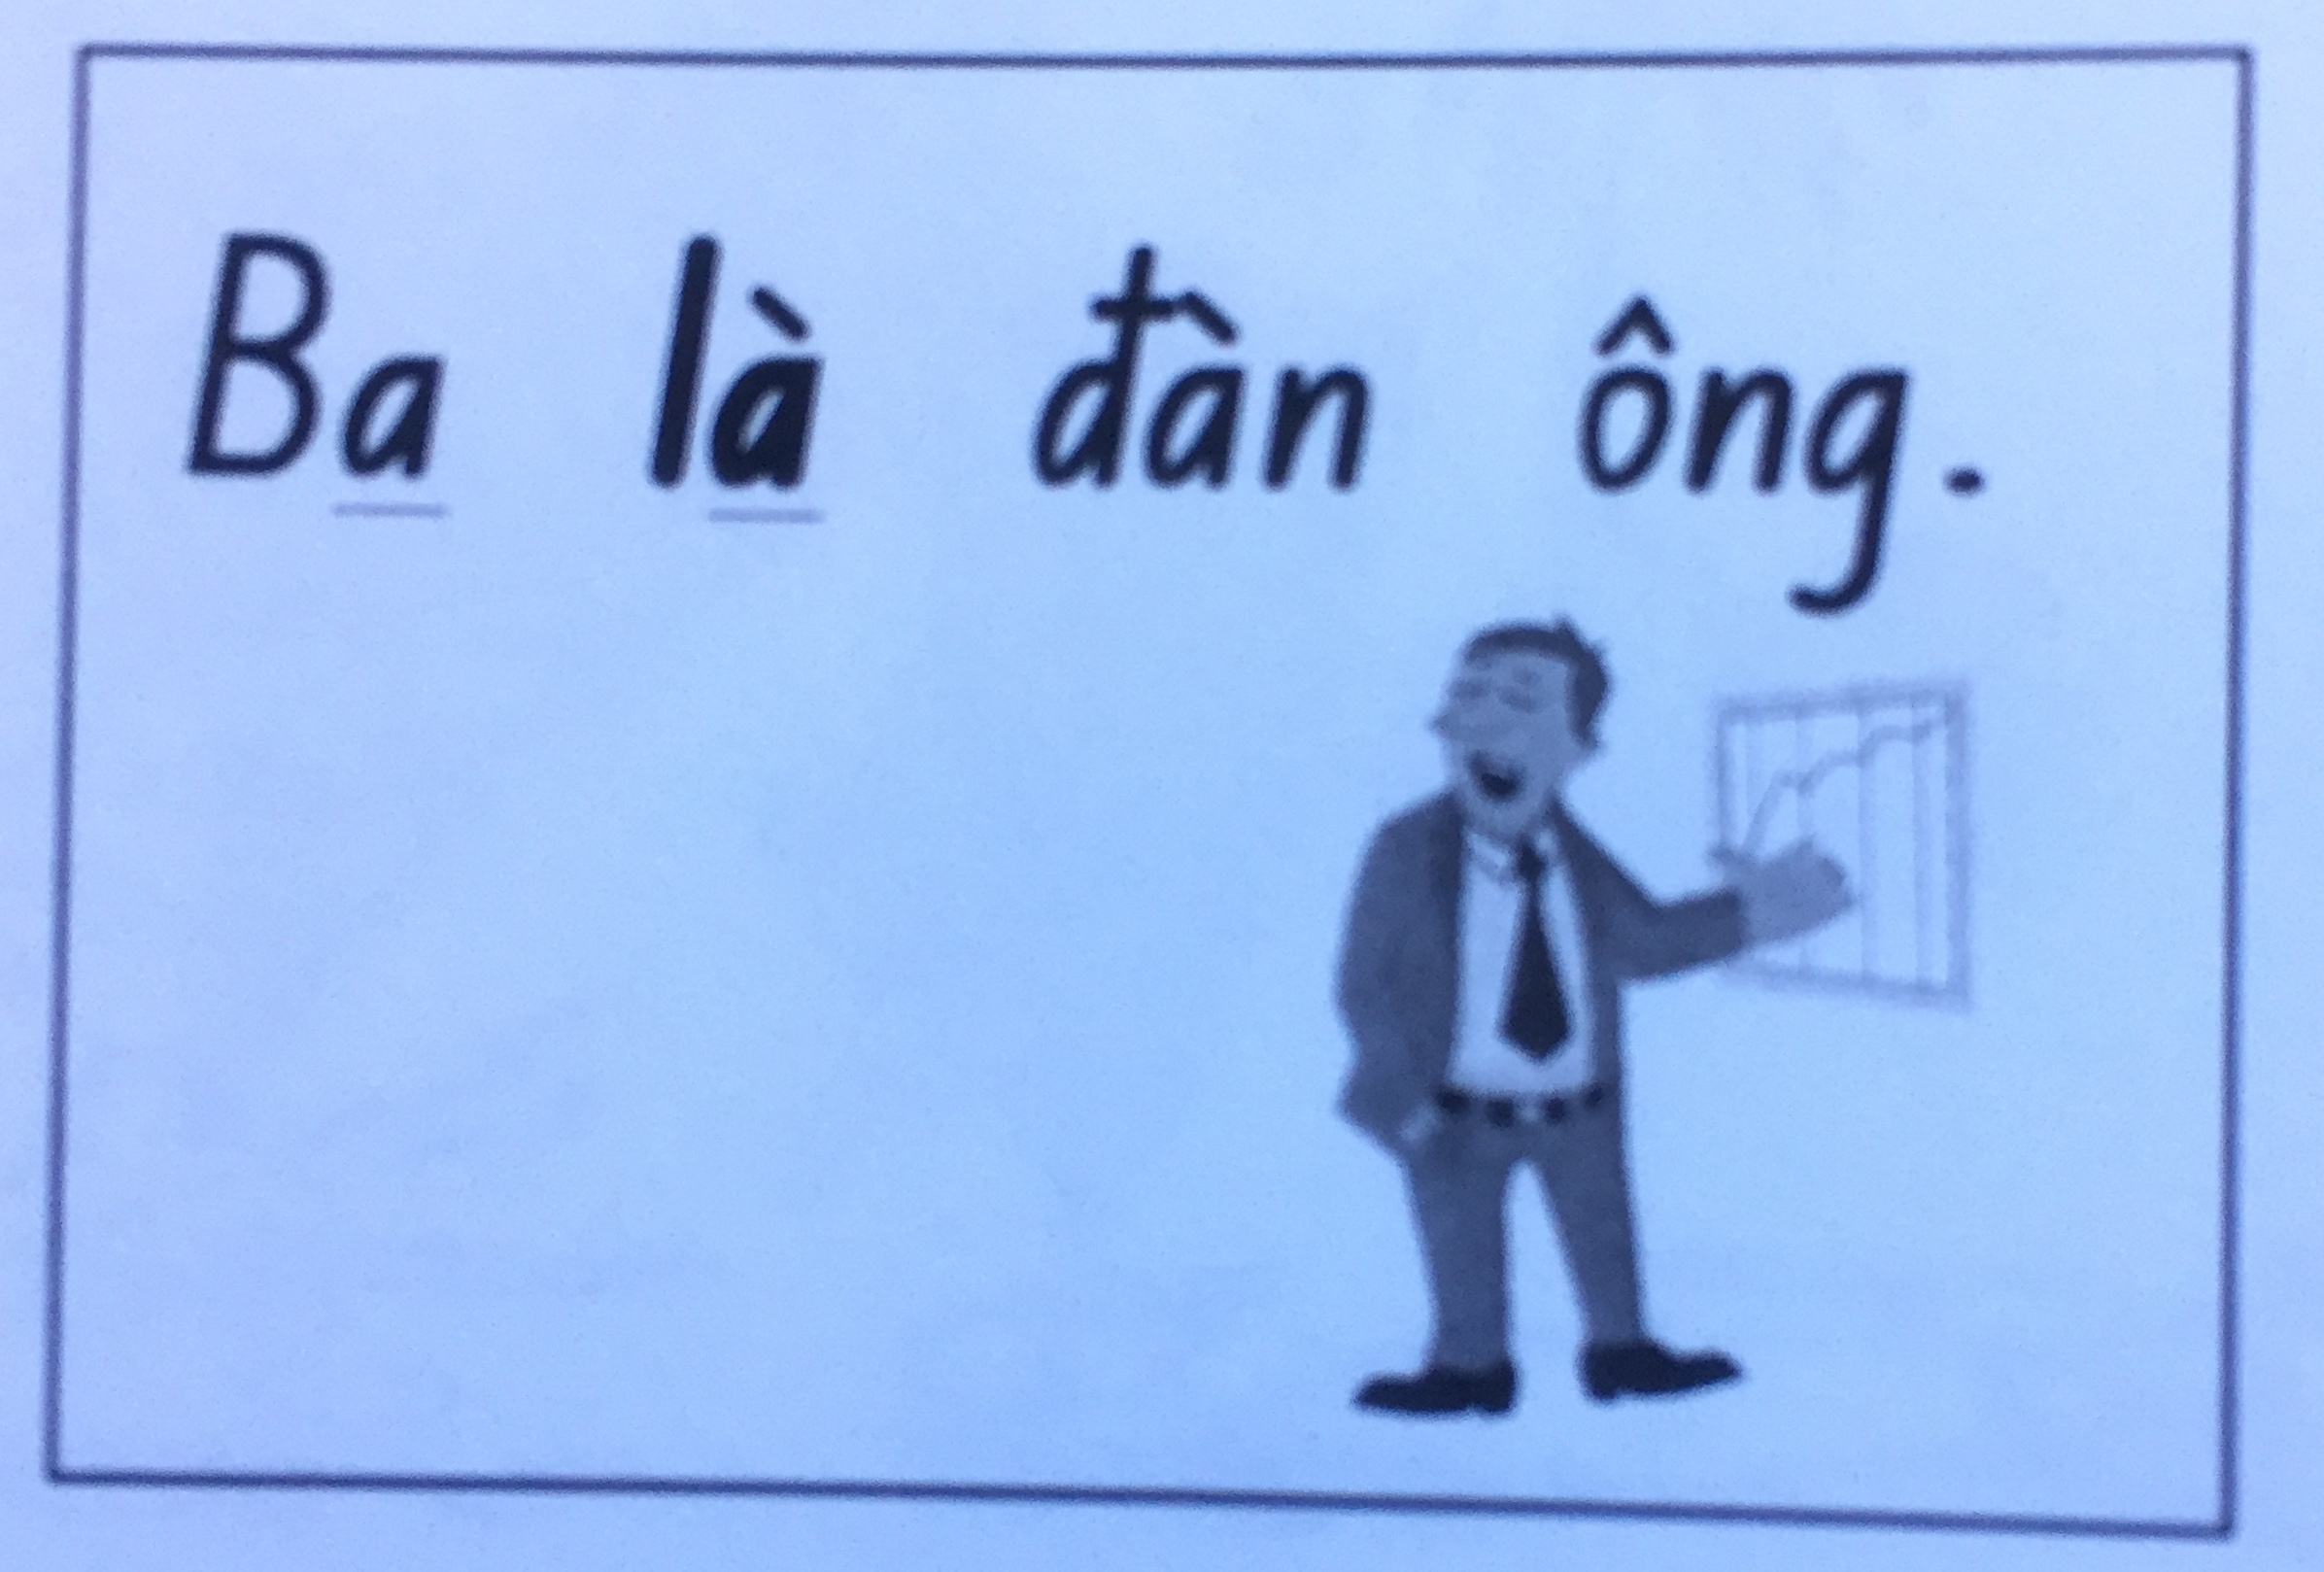
Prepared by My Trang Nguyen Vietnamese Cultural Schools Association Inc. Bankstown 2020

Slide 10
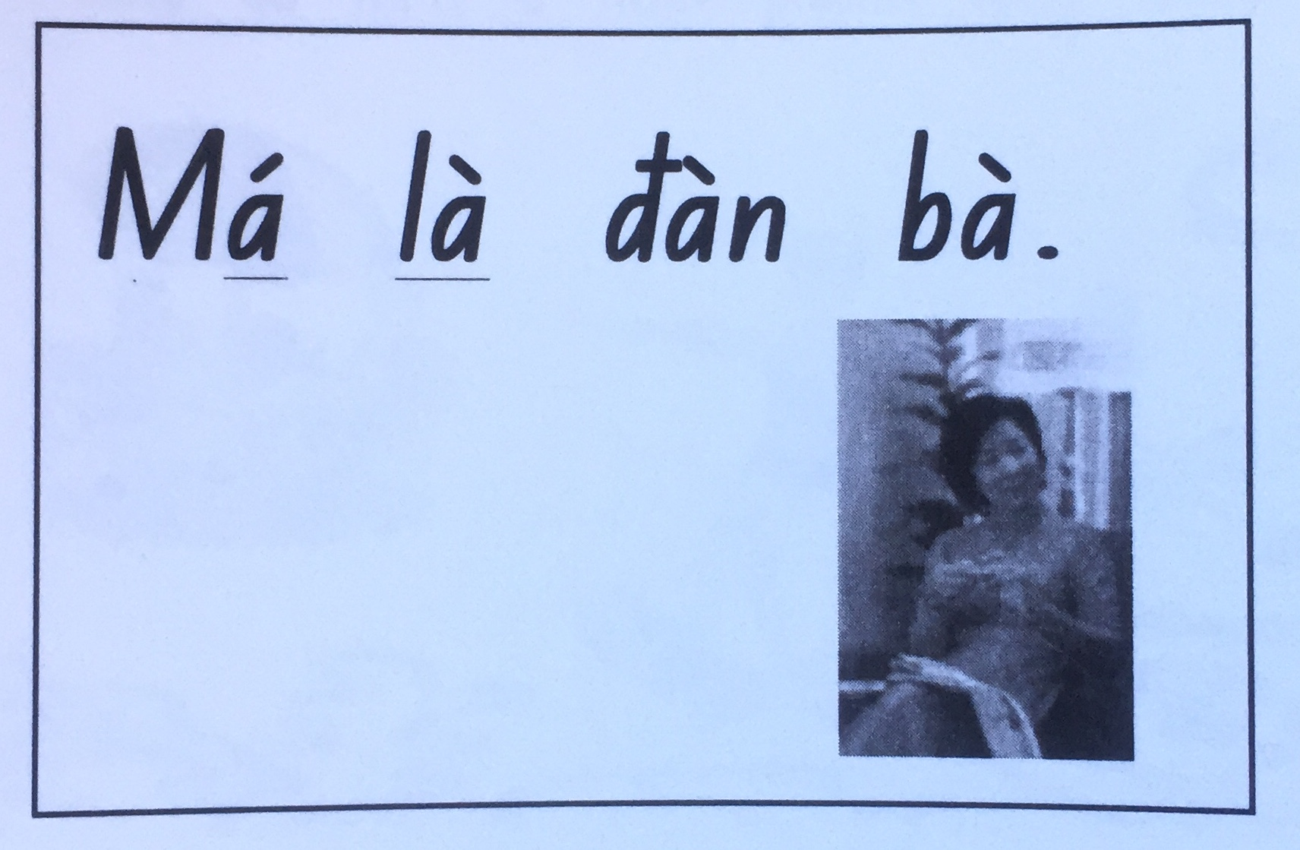
Prepared by My Trang Nguyen Vietnamese Cultural Schools Association Inc. Bankstown 2020

Slide 11
Prepared by My Trang Nguyen Vietnamese Cultural Schools Association Inc. Bankstown 2020

