Slide 1
Chữ Â
Cô Trang
Prepared by My Trang Nguyen Vietnamese Cultural Schools Association Inc. Bankstown 2020

Slide 2
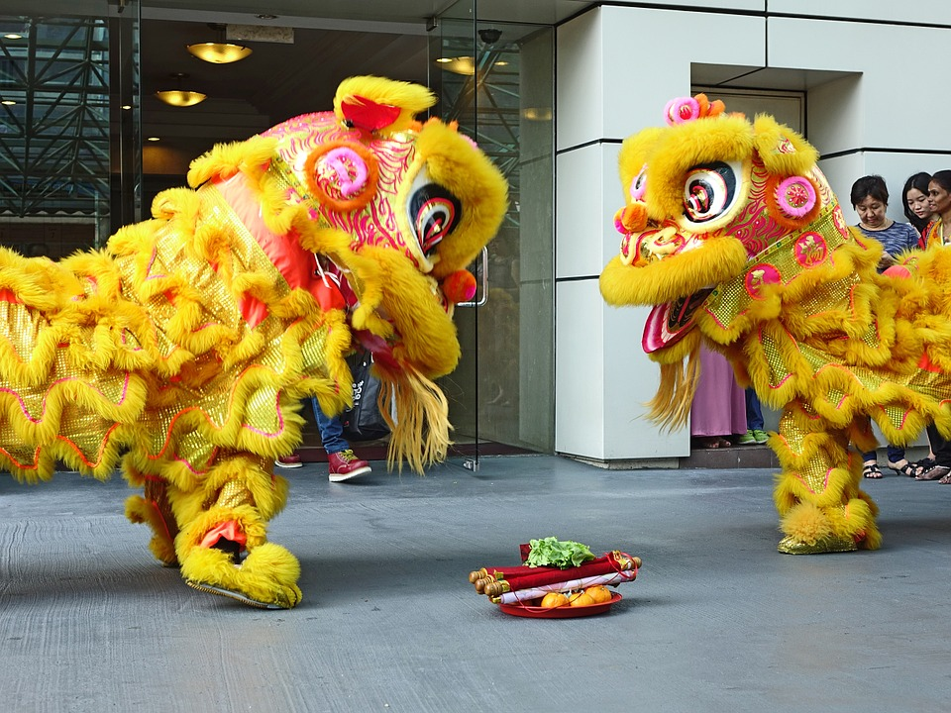
Lân
https://www.stockvault.net/data/2016/09/25/211051/thumb16.jpg
Prepared by My Trang Nguyen Vietnamese Cultural Schools Association Inc. Bankstown 2020

Slide 3
Cân
https://lh3.ggpht.com/m5PLdEkF1trvuPPGU5fQGE5bFlt3DeF-fMdrzb3zdrkuOosM07lofiaRvOG8aoFUIJCe=w300
Prepared by My Trang Nguyen Vietnamese Cultural Schools Association Inc. Bankstown 2020

Slide 4
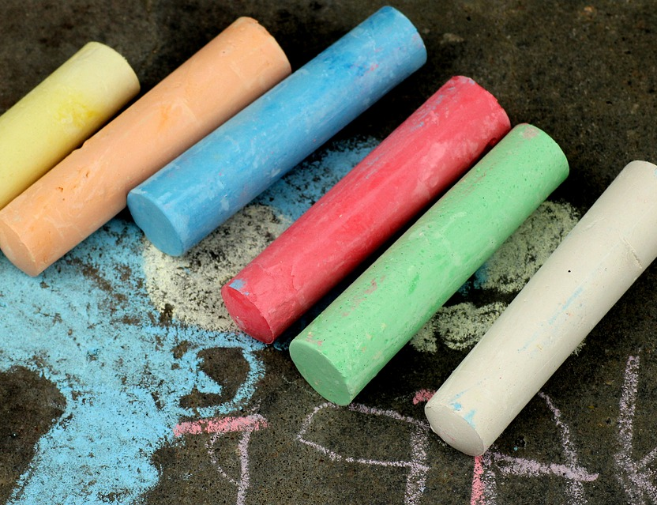
Phấn
https://pixabay.com/photos/chalk-color-to-draw-creativity-4161039/
Prepared by My Trang Nguyen Vietnamese Cultural Schools Association Inc. Bankstown 2020

Slide 5
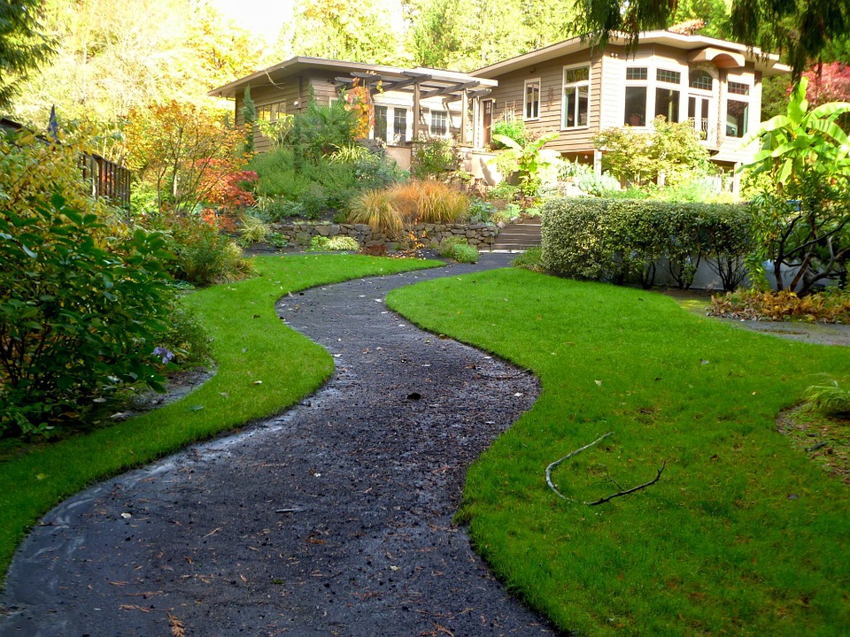
Sân
https://www.smartreno.com/blog/wp-content/uploads/2019/05/PastedGraphic-2-copy-440x328.jpg
Prepared by My Trang Nguyen Vietnamese Cultural Schools Association Inc. Bankstown 2020

Slide 6
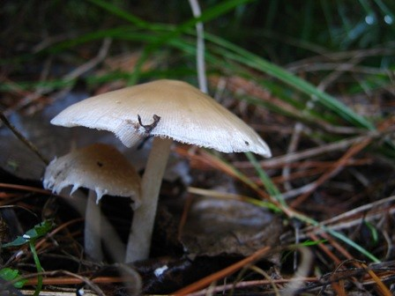
Nấm
https://www.nps.gov/gate/learn/nature/images/psathyrella_WS.JPG
Prepared by My Trang Nguyen Vietnamese Cultural Schools Association Inc. Bankstown 2020

Slide 7
Prepared by My Trang Nguyen Vietnamese Cultural Schools Association Inc. Bankstown 2020

Slide 8
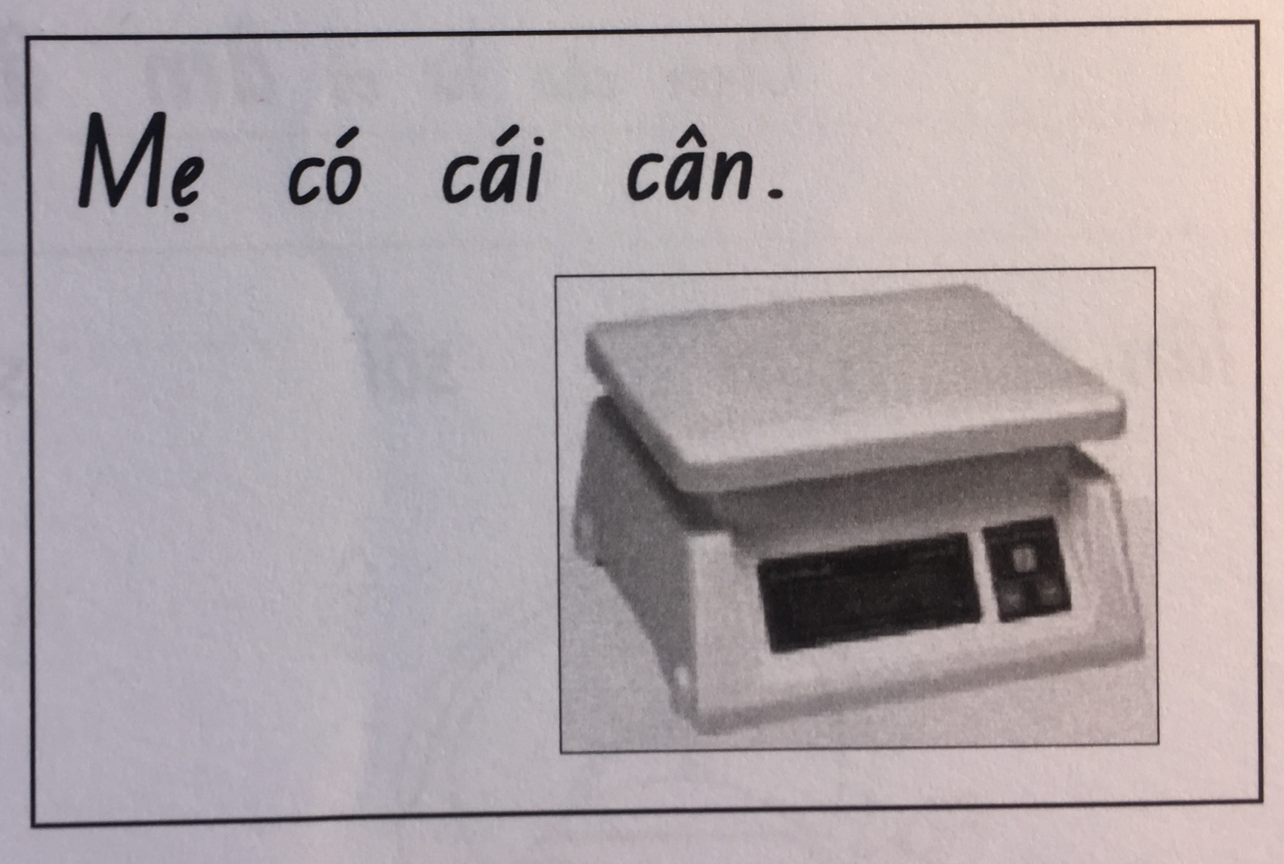
Prepared by My Trang Nguyen Vietnamese Cultural Schools Association Inc. Bankstown 2020

Slide 9
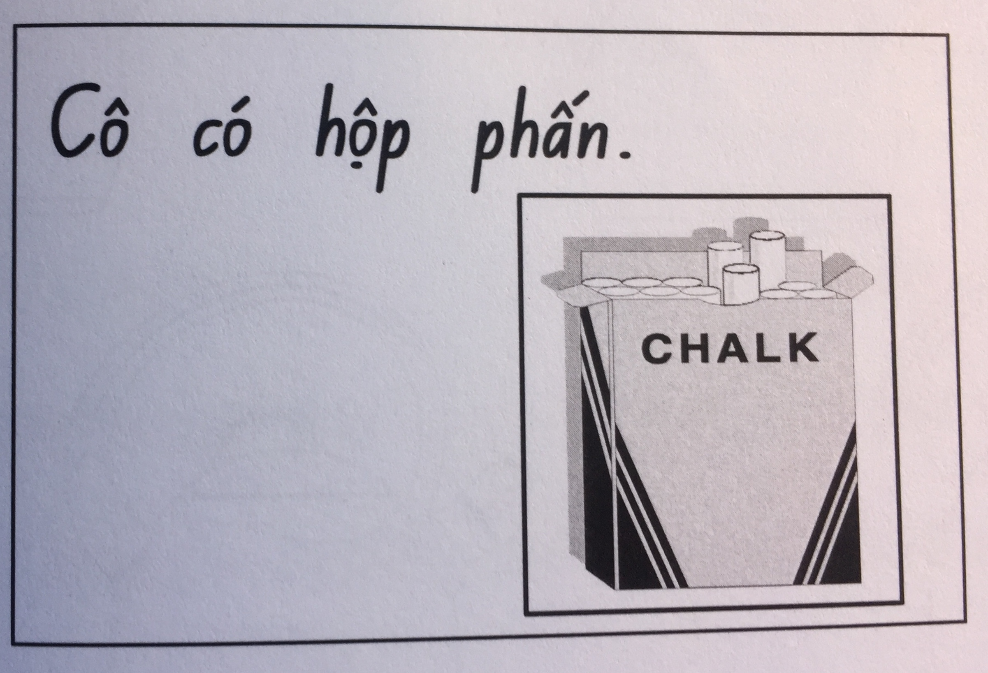
Prepared by My Trang Nguyen Vietnamese Cultural Schools Association Inc. Bankstown 2020

Slide 10
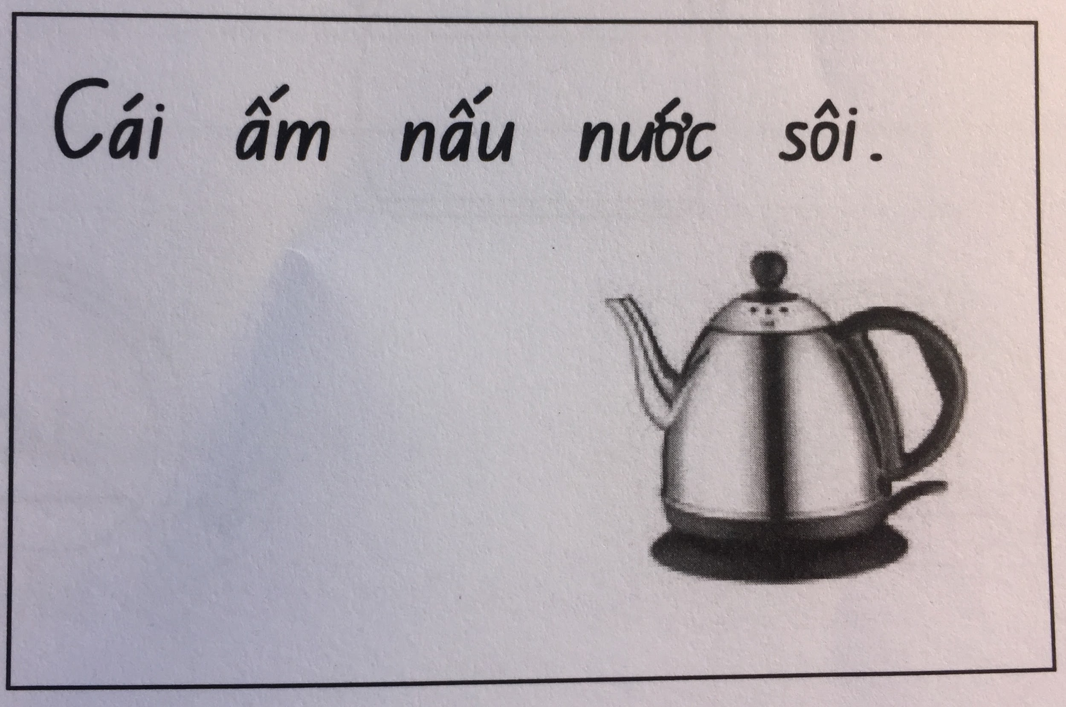
Prepared by My Trang Nguyen Vietnamese Cultural Schools Association Inc. Bankstown 2020

Slide 11
Prepared by My Trang Nguyen Vietnamese Cultural Schools Association Inc. Bankstown 2020

