Slide 1
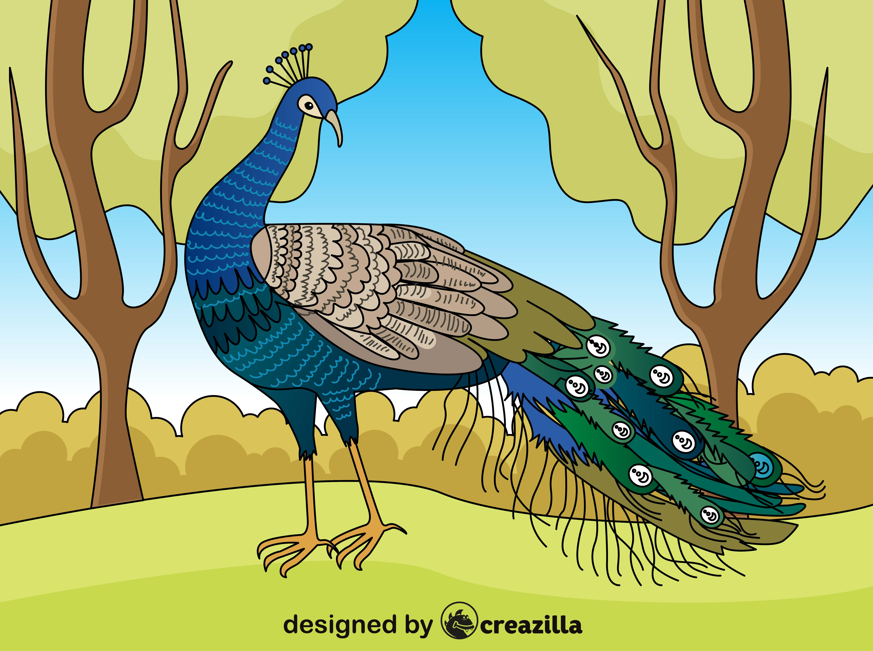
ACTIVITY 1
Find the Letters Challenge
ACTIVITY 2
Find the Words Challenge
ACTIVITY 3
Create a Story
Created by Amanpreet Kamal
Image: https://creazilla.com/nodes/63245-peacock-vector

Slide 2
FIND THE LETTERS CHALLENGE
ਖ
ਰ
ਕ
Can you find the letters in the picture?
ਰ
ਮ
ਕ
ਖ
ਮ
Activity Created by Amanpreet Kamal
Image: https://creazilla.com/nodes/63245-peacock-vector
Notes:
Great activity for students to identify the letters and describe where there are located in the picture.
Students can create words that start with these letters e.g. The letter ਕ, students might come up with words such as ਕਲਗੀ, ਕਾਰ, ਕਾਗਜ਼, ਕਿਤਾਬ etc.
Differentiation – Students who can only recognise letters can also participate by telling the first letter of each word.
Students who have the ability to read and recognise words can describe where each word is located in the picture.
Teachers can also ask students about the different colours used in the picture, use adjectives to describe the picture.
Another activity - students can create a story with what they see in the picture and can incorporate the words that they see in this picture into their story.

Slide 3
FIND THE WORDS CHALLENGE
ਕਲਗੀ
Can you find the words in the picture?
ਮੋਰ
ਕਲਗੀ
ਰੁੱਖ
ਮੋਰ
ਖੰਭ
ਰੁੱਖ
ਖੰਭ
Activity Created by Amanpreet Kamal
Image: https://creazilla.com/nodes/63245-peacock-vector
Notes:
Great activity for students to identify the letters and describe where there are located in the picture.
Students can create words that start with these letters e.g. The letter ਕ, students might come up with words such as ਕਲਗੀ, ਕਾਰ, ਕਾਗਜ਼, ਕਿਤਾਬ etc.
Differentiation – Students who can only recognise letters can also participate by telling the first letter of each word.
Students who have the ability to read and recognise words can describe where each word is located in the picture.
Teachers can also ask students about the different colours used in the picture, use adjectives to describe the picture.
Another activity - students can create a story with what they see in the picture and can incorporate the words that they see in this picture into their story.

Slide 4
CAN YOU CREATE A STORY USING ALL OF THESE WORDS?
ਕਲਗੀ kalgi crest
ਰੁੱਖ rukh tree
ਮੋਰ mor peacock
ਖੰਭ khamb feather
Activity Created by Amanpreet Kamal
Image: https://creazilla.com/nodes/63245-peacock-vector
Notes:
Another activity - students can create a story with what they see in the picture and can incorporate the words that they see in this picture into their story.

